Slide 2
MODULE 1 UNIT 2: OIL PALM PROCESSING

Slide 3
INTRODUCTION
Oil palm processing involves mechanical and chemical operations for extracting crude palm oil (CPO) and palm kernel oil (PKO).

Slide 4
Learning Objectives
Explain stages of processing
Importance of sterilization
Processes in kernel extraction
Factors affecting oil quality
Identify processing by‑products

Slide 5
Fresh Fruit Bunch (FFB) Processing Stages
Sterilization
Threshing
Digesting
Pressing
Clarification

Slide 6
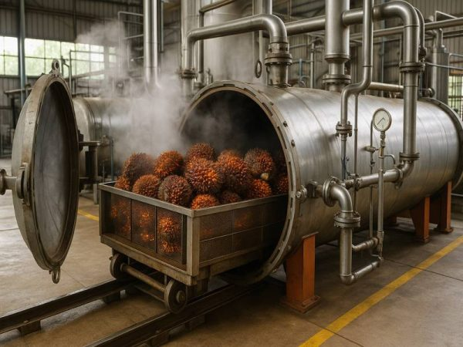
Sterilization
Kills pathogens
Stops enzyme activity
Loosens fruits from bunch
Improves oil quality
Typical temp: 140–150°C for 60–90 minutes

Slide 7
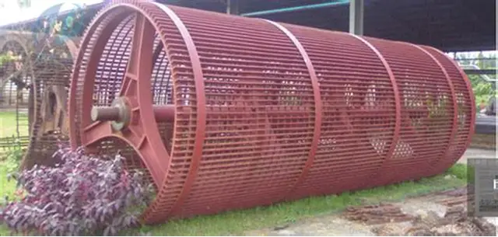
Threshing
Removes fruits from bunch stalks
Improves digestion efficiency
Threshing drum image

Slide 8
Digesting
Breaks down mesocarp
Separates pulp from kernel
Improves oil extraction efficiency
see: FINIC, Palm Fruit Digester

Slide 9
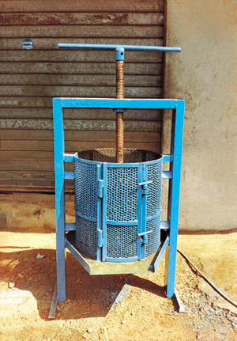
Pressing / Extraction
Uses screw press or hydraulic press
Extracts crude palm oil (CPO)
Manual Press for oil extraction

Slide 10
Clarification
Separates fibre and sludge from oil
Uses water and heating
Stores clarified oil for packaging

Slide 11
Palm Kernel Processing Stages
Fibre separation
Nut Drying
Nut Cracking
Kernel Oil Extraction
Storage

Slide 12
Nut Drying
Reduces moisture content
Improves cracking efficiency
Methods: machine drying, hot platform, sun drying
Kernel Oil Extraction
Mechanical pressing
Chemical extraction methods
Oil stored in tanks
Nuts stored in jute bags

Slide 13
Factors Affecting Oil Quality
Fruit ripeness
Sterilization temperature/time
Pressing conditions
Storage and handling practices
By‑products of Processing
Empty Fruit Bunches (EFB)
Palm Kernel Cake (PKC)
Palm Oil Mill Effluent (POME)

Slide 14
Uses of By‑products
EFB: fertilizer & bioenergy
PKC: animal feed
POME: requires treatment before disposal

Slide 15
Conclusion
Oil palm processing ensures production of edible oil, industrial raw materials, and valuable by‑products.

Slide 16
Self‑Assessment Questions
Why is threshing important?
Mention two drying methods
Effects of poor storage
What is POME?
Suggest sustainable practices

